Slide 3
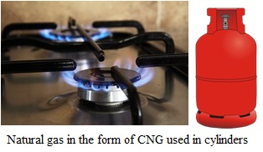
Natural Gas

Slide 5
Many useful substances are obtained from petroleum and natural gas. These are termed as ‘Petrochemicals’.
These are used in the manufacture of detergents, fibres (polyester, nylon, acrylic etc.), polythene and other man-made plastics. Hydrogen gas, obtained from natural gas, is used in the production of fertilizers. (Urea)

Slide 6
Substances obtained from Petrochemicals

Slide 10
Initiatives to Conserve Natural Resources
Drive at a constant or moderate speed.
Turn off the engine at traffic lights or wherever you have to wait for a while.
Regularly check tyre pressure.
Regularly ensure the servicing of the vehicle.

